Slide 1
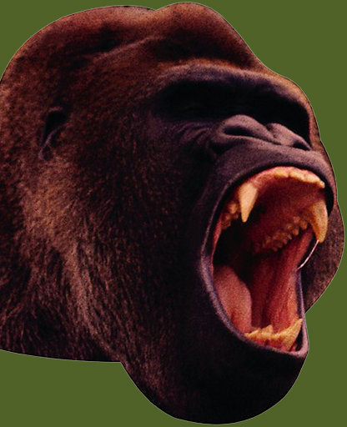
This presentation is brought to you by Grammar Bytes!, ©2014 by Robin L. Simmons.
chomp!
chomp!

Slide 2
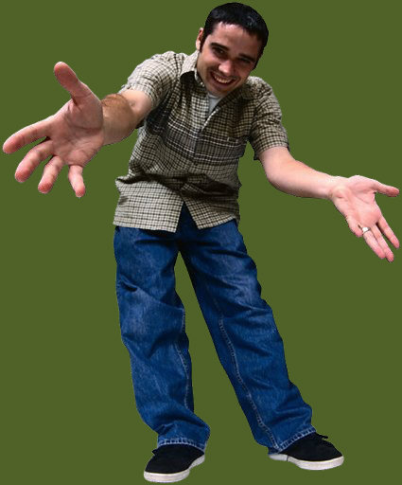
Pronoun Reference
Can I say just she?
Or do I have to use Esmerelda?

Slide 3
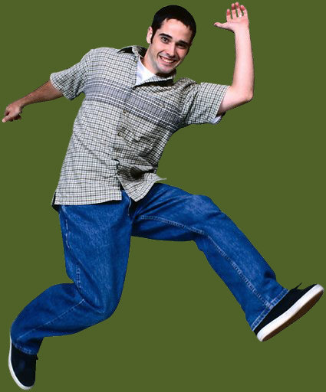
A pronoun reference item on an objective test might look like this . . .
This presentation covers identifying unclear pronoun reference and selecting the appropriate correction.

Slide 4
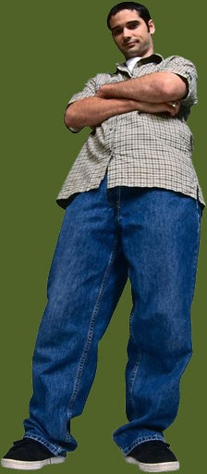
Sample Item
Bryan told his lab partner Craig that he
needed safety goggles for the experiment.
their
Craig
it
No change is necessary.
Bryan told his lab partner Craig that he
A B
needed safety goggles for the experiment.
C
their
Craig
it
No change is necessary.
Bryan told his lab partner Craig that Craig
A B
needed safety goggles for the experiment.
C
their
Craig
it
No change is necessary.
He is an ambiguous pronoun, which option B corrects.
Is his, he, or the experiment a problem?

Slide 5
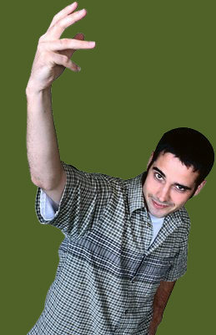
Two or More People, Same Gender
Martin complained to Brad that he did not have the right answers to the algebra problems.
Martin complained to Brad that Martin did not have the right answers to the algebra problems.
Martin complained to Brad that Brad did not have the right answers to the algebra problems.
Martin complained to Brad, “I do not have the right answers to the algebra problems.”
Martin complained to Brad, “You do not have the right answers to the algebra problems.”
Is Martin complaining about his own lack of math skill or Brad’s?
If you don’t like the repetition of the names, add a quotation.

Slide 6
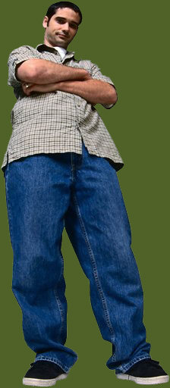
Ambiguous They
Our garden has not attracted many bees this year. They say that these insects are disappearing all over the country.
Our garden has not attracted many bees this year. Scientists say that these insects are disappearing all over the country.
They who? Psychics? Astrologers? Or a respectable source like entomologists?
The bees say! That’s who!
Notes:
Bee sound from http://www.brandens.net/snd_list.php?cat=Animals

Slide 7
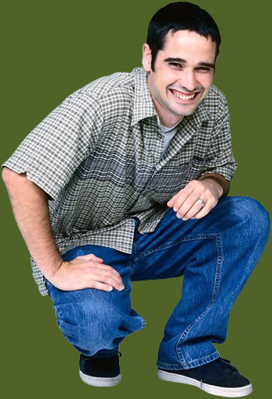
Ambiguous It
It says on the news that we can expect rain later today.
Tom Terry, Channel 9’s chief meteorologist, says that we can expect rain later today.
What says? A newscaster? The weatherman? Doppler radar?

Slide 8
Quick Test
Directions: In the items that follow, choose the option that corrects an error in the underlined portion(s). If no error exists, choose “No change is necessary.”
Your turn! Let’s see what you can do.

Slide 9
Item 1
We decided to swim in the hotel pool since it says at the lifeguard stand that sharks are feeding near shore.
it states at the lifeguard stand
they say at the lifeguard stand
the lifeguard says
No change is necessary.
We decided to swim in the hotel pool since it says at the lifeguard stand that sharks are feeding near shore.
it states at the lifeguard stand
they say at the lifeguard stand
the lifeguard says
No change is necessary.
We decided to swim in the hotel pool since it says at the lifeguard stand that sharks are feeding near shore.
it states at the lifeguard stand
they say at the lifeguard stand
the lifeguard says
No change is necessary.

Slide 10
Item 2
The doctor told Veronica that she had
headaches because of the high stress level at the
office. An aspirin would help the headaches a little,
but a vacation would relieve the stress best.
Doctor Lee
Veronica
it
No change is necessary.
The doctor told Veronica that she had A B
headaches because of the high stress level at the
office. An aspirin would help the headaches a little,
C
but a vacation would relieve the stress best.
Doctor Lee
Veronica
it
No change is necessary.
The doctor told Veronica that Veronica had A B
headaches because of the high stress level at the
office. An aspirin would help the headaches a little,
C
but a vacation would relieve the stress best.
Doctor Lee
Veronica
it
No change is necessary.
Notes:
Add slide: “Doctors can be female, you know.”

Slide 11
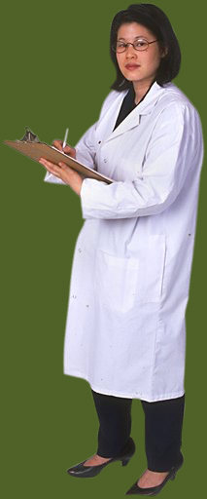
Don’t assume all doctors are male!

Slide 12
Item 3
Freddie is unhappy with the unhealthy cafeteria choices. They are serving more fried foods and fewer fruits and vegetables.
The chefs are serving
It is
They prepare
No change is necessary.
Freddie is unhappy with the unhealthy cafeteria choices. They are serving more fried foods and fewer fruits and vegetables.
The chefs are serving
It is
They prepare
No change is necessary.
Freddie is unhappy with the unhealthy cafeteria choices. They are serving more fried foods and fewer fruits and vegetables.
The chefs are serving
It is
They prepare
No change is necessary.

Slide 13
Item 4
They say that the old house on Mayfair is
haunted, but Caroline doesn’t believe the stories.
She is a physics major who has no use for ghosts.
Neighbors
it
them
No change is necessary.
They say that the old house on Mayfair is A
haunted, but Caroline doesn’t believe the stories.
B
She is a physics major who has no use for ghosts.
C
Neighbors
it
them
No change is necessary.
Neighbors say that the old house on Mayfair is A
haunted, but Caroline doesn’t believe the stories.
B
She is a physics major who has no use for ghosts.
C
Neighbors
it
them
No change is necessary.

Slide 14
Item 5
Leonardo called us over and pointed at the computer screen. It claimed at the website that our favorite restaurant serves squirrel!
At the website, it claimed
The website claimed
The website, it claimed
No change is necessary.
Leonardo called us over and pointed at the computer screen. It claimed at the website that our favorite restaurant serves squirrel!
At the website, it claimed
The website claimed
The website, it claimed
No change is necessary.
Leonardo called us over and pointed at the computer screen. It claimed at the website that our favorite restaurant serves squirrel!
At the website, it claimed
The website claimed
The website, it claimed
No change is necessary.

Slide 15
Item 6
Mom told Aunt Julia that she didn’t raise her children
right. The girls didn’t chew with their mouths closed,
and the boys burped without excusing themselves.
Mom
them
it
No change is necessary.
Mom told Aunt Julia that she didn’t raise her children
A
right. The girls didn’t chew with their mouths closed,
B
and the boys burped without excusing themselves.
C
Mom
them
it
No change is necessary.
Mom told Aunt Julia that Mom didn’t raise her children
A
right. The girls didn’t chew with their mouths closed,
B
and the boys burped without excusing themselves.
C
Mom
them
it
No change is necessary.

Slide 16
Item 7
Mom told Aunt Julia that she needed a lion tamer to get the children under control.
Julia, “that she needed … control.”
Julia, “I need … control.”
Julia, You need … control.
No change is necessary.
Mom told Aunt Julia that she needed a lion tamer to get the children under control.
Julia, “that she needed … control.”
Julia, “I need … control.”
Julia, You need … control.
No change is necessary.
Mom told Aunt Julia that she needed a lion tamer to get the children under control.
Julia, “that she needed … control.”
Julia, “I need … control.”
Julia, You need … control.
No change is necessary.

Slide 17
Item 8
NASA just landed another rover on Mars.
They say if water is evident, the government
will begin colonization plans.
one
Scientists
it
No change is necessary.
NASA just landed another rover on Mars. A
They say if water is evident, the government
B C
will begin colonization plans.
one
Scientists
it
No change is necessary.
NASA just landed another rover on Mars. A
Scientists say if water is evident, the government
B C
will begin colonization plans.
one
Scientists
it
No change is necessary.

Slide 18
Item 9
Put that back on the shelf! The label says that high fructose corn syrup and partially hydrogenated oils are ingredients.
It says on the label
They claim on the label
On the label it says
No change is necessary.
Put that back on the shelf! The label says that high fructose corn syrup and partially hydrogenated oils are ingredients.
It says on the label
They claim on the label
On the label it says
No change is necessary.
Put that back on the shelf! The label says that high fructose corn syrup and partially hydrogenated oils are ingredients.
It says on the label
They claim on the label
On the label it says
No change is necessary.

Slide 19
Item 10
Maria explained to Diane that her sauce was too
salty and too garlicky and would give everyone
heartburn.
Sara’s
him
it
No change is necessary.
Maria explained to Diane that her sauce was too
A
salty and too garlicky and would give everyone
B
heartburn.
C
Sara’s
him
it
No change is necessary.
Maria explained to Diane that Sara’s sauce was too
A
salty and too garlicky and would give everyone
B
heartburn.
C
Sara’s
him
it
No change is necessary.

Slide 20
Grammar Bytes! provides additional handouts and exercises on pronoun reference. Go to chompchomp.com!
chomp!
chomp!

Slide 21
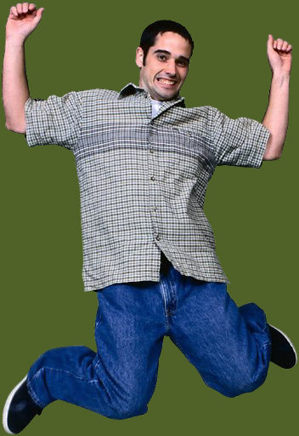
The End.

